Slide 1
random Quote generator.
Summited to :
Pritpal ma’am
Summited by:
Bhumi Gurung

Slide 2
Creating a Random Quote Generator in React
Introduction: A Random Quote Generator is a simple web application that displays random quotes when a user interacts with it. In this report, we will discuss how to create a Random Quote Generator using the React library. React is a popular JavaScript library for building user interfaces, and it provides a straightforward way to create interactive web applications.

Slide 3
Key Features:
Random Quote Generation: The application will generate random quotes each time the user requests a new one.
User Interaction: Users can trigger the display of a new quote with a button click, making the application interactive and engaging.
Simple User Interface: The user interface will be clean and intuitive, with a focus on displaying quotes prominently.
Responsive Design: The application will be responsive to different screen sizes and devices.

Slide 4
Step-by-Step Implementation:
Setting Up the Project:
First, you need to set up a React project. You can do this using create-react-app or by configuring a build tool like Webpack or Parcel.
Storing Quotes:
You can store a list of quotes in an array or fetch them from an API. For simplicity, you can create an array of quotes in your component or import them from an external file.

Slide 5
Random Quote Generation:
Write a function to select a random quote from your list of quotes and update the state with the new quote when the user clicks the button.
User Interface:
Design the user interface with CSS to make it visually appealing. You can use CSS frameworks like Bootstrap or Material-UI for a quick and attractive layout.

Slide 6
Conclusion: Creating a Random Quote Generator in React is a fun and educational project that allows you to practice React concepts such as component structure, state management, event handling, and responsive design. By following the steps outlined in this report, you can build a simple yet engaging web application that provides users with random quotes at the click of a button. This project can serve as a starting point for more complex React applications and help you gain a deeper understanding of React development.

Slide 7
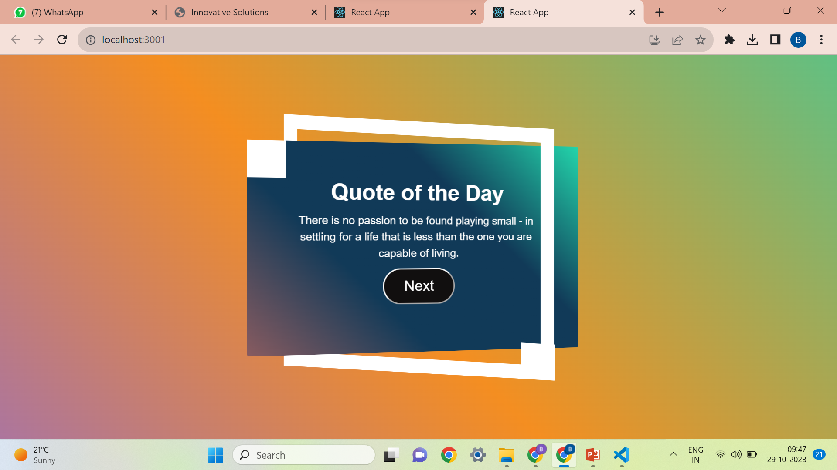

Slide 8
Thanks…….

